Slide 1
Se non le Scuole eTwinning, chi altri?
Santi Scimeca

Slide 4
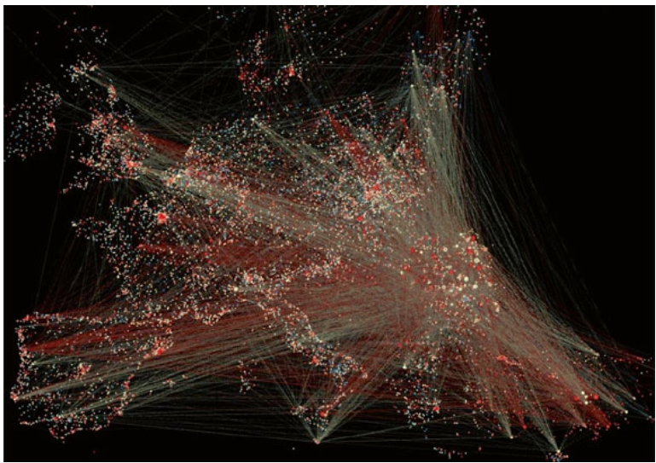

Slide 5
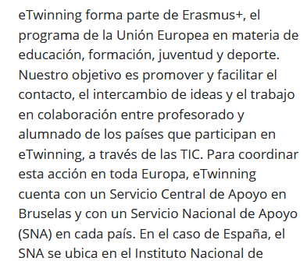

Slide 6
ONLINE POLL
«Cos’è eTwinning in una parola?»

Slide 8
Finalmente,
le Scuole eTwinning

Slide 10
Shared leaderhip
collaborazione e condivisione
Student Agency
Modello per altre scuole
Inclusività e innovazione

Slide 11
eTwinning Monitoring Report 2020 – key findings
Twinning Schools have a commitment to shared leadership
The notion and the practice of Shared leadership is the one which seems to be more established: this confirms that eTwinning Schools are, at least structurally, ready to adopt more flexible decision-making and leadership structures.
eTwinning Schools display a strong commitment to collaboration, sharing and teamwork
Collaboration among teachers and among students is strong and effective but more development and further practice is needed in establishing collaboration between students and teachers, especially outside eTwinning projects.
eTwinning Schools are models for other schools, but networking could be improved
Serving as a Learning hub, eTwinning schools generally engage in mentoring of other schools and can serve as source of inspiration of eTwinning practice in their region or state, but at the same time teachers feel that their school is not entirely ready to be involved in school-to-school networks and collaboration.
eTwinning Schools are inclusive and innovative learning organisations
eTwinning Schools are innovative and inclusive learning organisations and establish a culture of inquiry, innovation and exploration, in which students’ learning is placed at the center and diversity is valued.
eTwinning need a more proactive role towards the local community
Synergies between the school and the local community, including parents, local associations, local authority, would deserve a stronger establishment and a consolidated school development plan, thus formalising the schools’ role within the local context.

Slide 12
eTwinning Monitoring Report 2020 - Key recommendations
eTwinning Schools should find ways to systematically involve the whole school community and give each actor (teachers, pupils, Principals, parents) responsibilities and opportunities which can be leveraged via eTwinning activities.
The eTwinning School Label should be considered a milestone of a journey and, Ideally, the eTwinning School Mission should be integrated as part of each school’s mission.
eTwinning Schools need consistent and constant guidance and professional development activities to keep them motivated on one side, and to monitor their progression, on the other. This can be achieved by providing dedicated courses, webinars, materials and opportunities, and at the same time by enhancing the community feeling already present.
eTwinning Schools need recognition of their work by the European, national and regional authorities, as mainstreaming eTwinning practices cannot rely solely on the individual school’s practice but should be promoted and implemented at systemic level.

Slide 13
Le Scuole eTwinning non sono tali perché sono le migliori, ma perché hanno il potenziale di cambiare l’intero sistema scolastico.
Se non le Scuole eTwinning, chi altri?

Slide 14
ONLINE POLL
«Cosa farete, da domani, per agire come Scuole eTwinning?»

